Slide 1
The Theory of NP-Completeness

Slide 2
Nondeterministic algorithms
A nondeterminstic algorithm consists of
phase 1: guessing
phase 2: checking
If the checking stage of a nondeterministic algorithm is of polynomial time-complexity, then this algorithm is called an NP (nondeterministic polynomial) algorithm.
NP problems :
  e.g. searching, MST
    sorting
    satisfiability problem (SAT)
    traveling salesperson problem (TSP)

Slide 3
A nondeterministic algorithm terminates unsuccessfully iff there exist not a set of choices leading to a success signal.
A deterministic interpretation of a non-deterministic algorithm can be made by allowing unbounded parallelism in computation.
The runtime required for choice(1 : n) is O(1).
The runtime for nondeterministic searching algorithm is also O(1)

Slide 4
Nondeterministic sorting
B ← 0
/* guessing */
for i = 1 to n do
j ← choice(1 : n)
if B[j] ≠ 0 then failure
B[j] = A[i]
/* checking */
for i = 1 to n-1 do
if B[i] > B[i+1] then failure
success

Slide 5
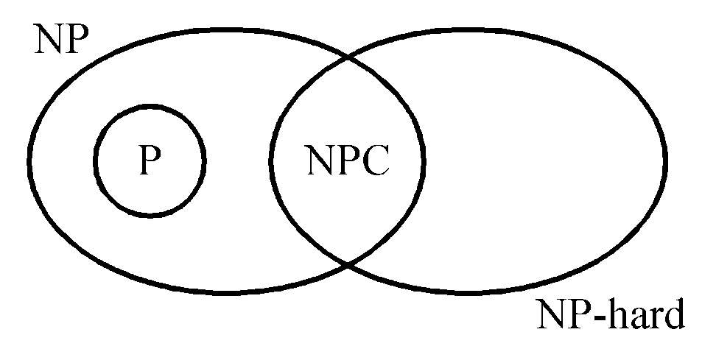
NP : the class of decision problem which can be solved by a non-deterministic polynomial algorithm.
P: the class of problems which can be solved by a deterministic polynomial algorithm.
NP-hard: the class of problems to which every NP problem reduces.
NP-complete (NPC): the class of problems which are NP-hard and belong to NP.

Slide 6
Some concepts of NPC
Definition of reduction: Problem A reduces to problem B (A ∝ B) iff A can be solved by a deterministic polynomial time algorithm using a deterministic algorithm that solves B in polynomial time. B is harder.
Up to now, none of the NPC problems can be solved by a deterministic polynomial time algorithm in the worst case.
It does not seem to have any polynomial time algorithm to solve the NPC problems.

Slide 7
The theory of NP-completeness always considers the worst case.
The lower bound of any NPC problem seems to be in the order of an exponential function.
Not all NP problems are difficult. (e.g. the MST problem is an NP problem.)
If A, B ∈ NPC, then A ∝ B and B ∝ A.
Theory of NP-completeness
If any NPC problem can be solved in polynomial time, then all NP problems can be solved in polynomial time. (NP = P)

Slide 8
Decision problems
The solution is simply “Yes” or “No”.
Optimization problems are more difficult.
e.g. the traveling salesperson problem
  Optimization version:
  Find the shortest tour
  Decision version:
  Is there a tour whose total length is less than or equal to a constant c ?

Slide 9
Solving an optimization problem by a decision algorithm :
Solving TSP optimization problem by decision algorithm :
  Give c₁ and test (decision algorithm)
Give c₂ and test (decision algorithm)

Give c_{n} and test (decision algorithm)
  We can find the smallest c_{i}

Slide 10
The satisfiability problem
The satisfiability problem
  The logical formula :
x₁ v x₂ v x₃
& - x₁
& - x₂
  the assignment :
x₁ ← F , x₂ ← F , x₃ ← T
  will make the above formula true .
(-x₁, -x₂ , x₃) represents x₁ ← F , x₂ ← F , x₃ ← T

Slide 11
If there is at least one assignment which satisfies a formula, then we say that this formula is satisfiable; otherwise, it is unsatisfiable.
An unsatisfiable formula :
  x₁ v x₂
  & x₁ v -x₂
  & -x₁ v x₂
  & -x₁ v -x₂

Slide 12
Definition of the satisfiability problem: Given a Boolean formula, determine whether this formula is satisfiable or not.
A literal : x_{i} or -x_{i}
A clause : x₁ v x₂ v -x₃ ≡ C_{i}
A formula : conjunctive normal form
C₁& C₂ & … & C_{m}

Slide 13
Cook’s theorem
NP = P iff the satisfiability problem is a P problem.
SAT is NP-complete.
It is the first NP-complete problem.
Every NP problem reduces to SAT.

Slide 14
Toward NP-Completeness
Once we have found an NP-complete problem, proving that other problems are also NP-complete becomes easier.
Given a new problem Y, it is sufficient to prove that Cook’s problem, or any other NP-complete problems, is polynomially reducible to Y. Known problem -> unknown problem

Slide 15
NP-Completeness Proof
Assume that CLIQUE problem is NP-complete, to prove that vertex cover (VC) problem is NP-complete.
Definition:
A vertex cover of G=(V, E) is V’⊆V such that every edge in E is incident to some v∈V’.
Vertex Cover(VC): Given undirected G=(V, E) and integer k, does G have a vertex cover with ≤k vertices?
CLIQUE: Does G contain a clique of size ≥k?

Slide 16
NP-Completeness Proof: Vertex Cover(VC)
Problem: Given undirected G=(V, E) and integer k, does G have a vertex cover with ≤k vertices?
Theorem: the VC problem is NP-complete.
Proof: (Reduction from CLIQUE)
  VC is in NP. This is trivial since we can check it easily in polynomial time.
  Goal: Transform arbitrary CLIQUE instance into VC instance such that CLIQUE answer is “yes” iff VC answer is “yes”.

Slide 17

NP-Completeness Proof: Vertex Cover(VC)
  Claim: CLIQUE(G, k) has same answer as VC ( , n-k), where n = |V|.
  Observe: There is a clique of size k in G iff there is a VC of size n-k in .

Slide 18

NP-Completeness Proof: Vertex Cover(VC)
  Observe: If D is a VC in , then has no edge between vertices in V-D.
  So, we have k-clique in G n-k VC in
  Can transform in polynomial time.

Slide 19
NP-Completeness Proof: CLIQUE
Assume that SAT problem is NP-complete, to prove that CLIQUE problem is NP-complete
Problem: Does G=(V,E) contain a clique of size k?
Theorem: Clique is NP-Complete. (reduction from SAT)
Idea: Make “column” for each of k clauses.
  No edge within a column.
  All other edges present except between x and x’

Slide 20
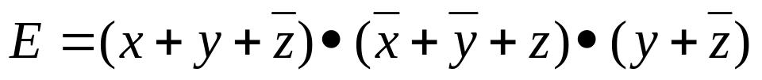






NP-Completeness Proof: CLIQUE
Example:
G =
G has m-clique (m is the number of clauses in E), iff E is satisfiable.
(Assign value 1 to all variables in clique)

Slide 21
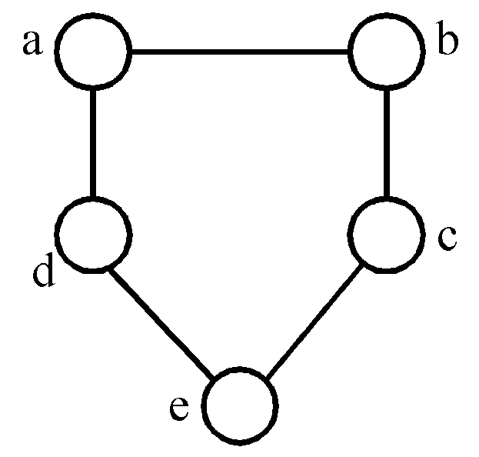
Graph coloring problem
Def: A coloring of a graph G=(V, E) is a function f : V → { 1, 2, 3,…, k } such that if (u, v) ∈ E, then f(u)≠f(v). The graph coloring problem is to determine if G has a coloring for k.
E.g.
3-colorable
f(a)=1, f(b)=2, f(c)=1
f(d)=2, f(e)=3

Slide 22



Set cover problem
Def: F = {S_{i}} = { S₁, S₂, …, S_{k} }
S_{i} = { u₁, u₂, …, u_{n} }
T is a set cover of F if T ⊆ F and S_{i} = S_{i}
The set cover decision problem is to determine if F has a cover T containing no more than c sets.
Example
F = {(a₁, a₃), (a₂, a₄), (a₂, a₃), (a₄), (a₁, a₃ , a₄)}
s₁ s₂ s₃ s₄ s₅
T = { s₁, s₃, s₄ } set cover

Slide 23
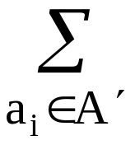
Subset sum problem
Def: A set of positive numbers A = { a₁, a₂, …, a_{n} }
  a constant C
  Determine if ∃ A′ ⊆ A s.t. a_{i} = C
e.g. A = { 7, 5, 19, 1, 12, 8, 14 }
  C = 21, A′ = { 7, 14 }
  C = 11, no solution

Slide 24
Partition problem
Def: Given a set of positive numbers A = { a₁,a₂,…,a_{n} },
determine if ∃ a partition P, s.t. ∑a_{i} = ∑a_{i}
i∈p i∉p
e. g. A = {3, 6, 1, 9, 4, 11}
partition : {3, 1, 9, 4} and {6, 11}

Slide 25
Bin packing problem
Def: n items, each of size c_{i} , c_{i} > 0
bin capacity : C
Determine if we can assign the items into
k bins, s.t. ∑c_{i} ≤ C , 1≤j≤k.
i∈bin_{j}

Slide 26
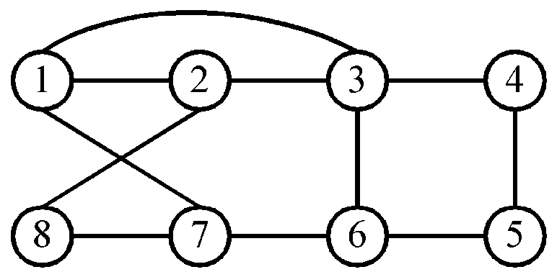
Hamiltonian cycle problem
Def: A Hamiltonian cycle is a round trip path along n edges of G which visits every vertex once and returns to its starting vertex.
e.g.
Hamiltonian cycle : 1, 2, 8, 7, 6, 5, 4, 3, 1.

Slide 27
Traveling salesperson problem
Def: A tour of a directed graph G=(V, E) is a directed cycle that includes every vertex in V. The problem is to find a tour of minimum cost.

Slide 28
0/1 knapsack problem
Def: n objects, each with a weight w_{i} > 0
a profit p_{i} > 0
capacity of knapsack : M
Maximize ∑p_{i}x_{i}
1≤i≤n
Subject to ∑w_{i}x_{i} ≤ M
1≤i≤n
x_{i} = 0 or 1, 1≤ i ≤n
Decision version :
Given K, ∃ ∑p_{i}x_{i} ≥ K ?
1≤i≤n
Knapsack problem : 0 ≤ x_{i} ≤ 1, 1≤ i ≤n.

Slide 29
Subset sum problem
Reduce from 3SAT problem to show that subset sum problem is NP-complete.

Slide 30
Three dimensional matching problem
Reduce from 3SAT problem to show that three dimensional matching (3DM) problem is NP-complete.

Slide 31
Summary
NP-hard and NP-complete
NP-completeness proof
Polynomial time reduction
List of NP-complete problems
Knapsack problem

